Slide 1
The Festive Effect: Analyzing Seasonal Impact on E-commerce Sales

Slide 2
Understanding Our Dataset
Intro: This is a large, real-world dataset with over two years of sales transactions from a UK-based online gift store.
Pros: Its two-year duration is perfect for seasonal trend analysis, while rich customer data allows for deep behavioral insights.
Cons: The data is not recent and is from the UK, not India, plus it requires significant cleaning of missing values.

Slide 3
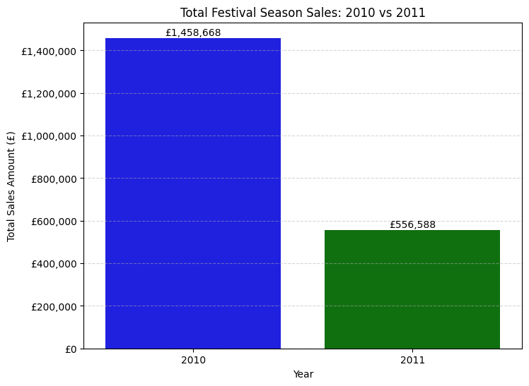
Festival Season Sales: 2010 vs 2011

Slide 4
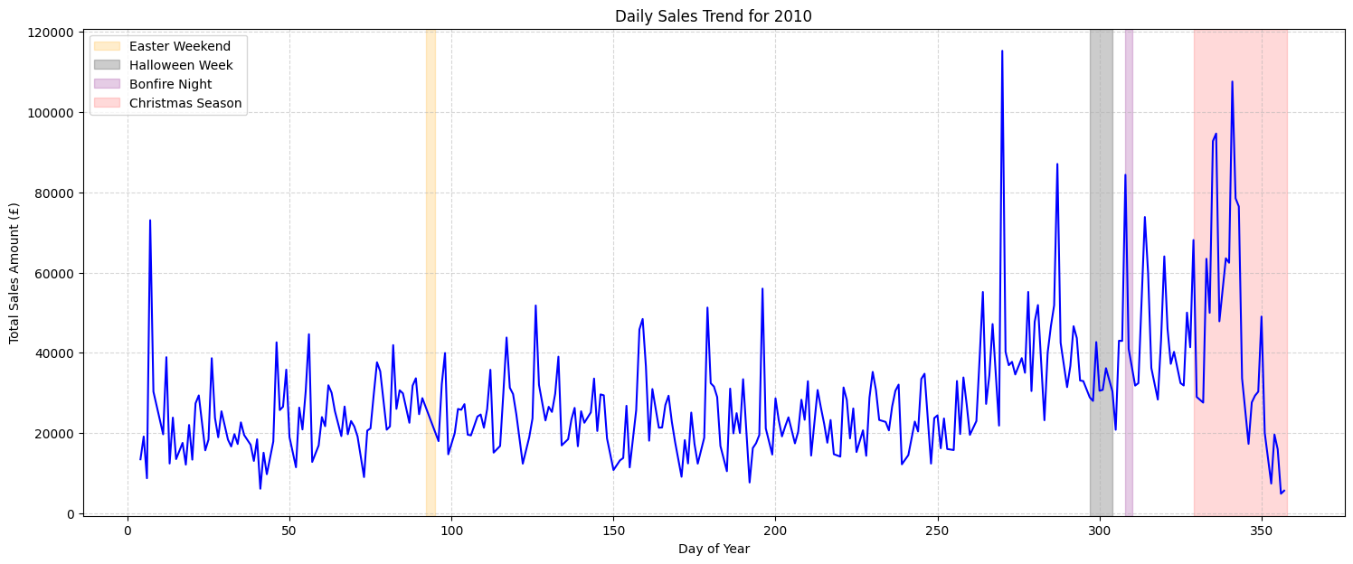
Daily Sales trends For 2010

Slide 5
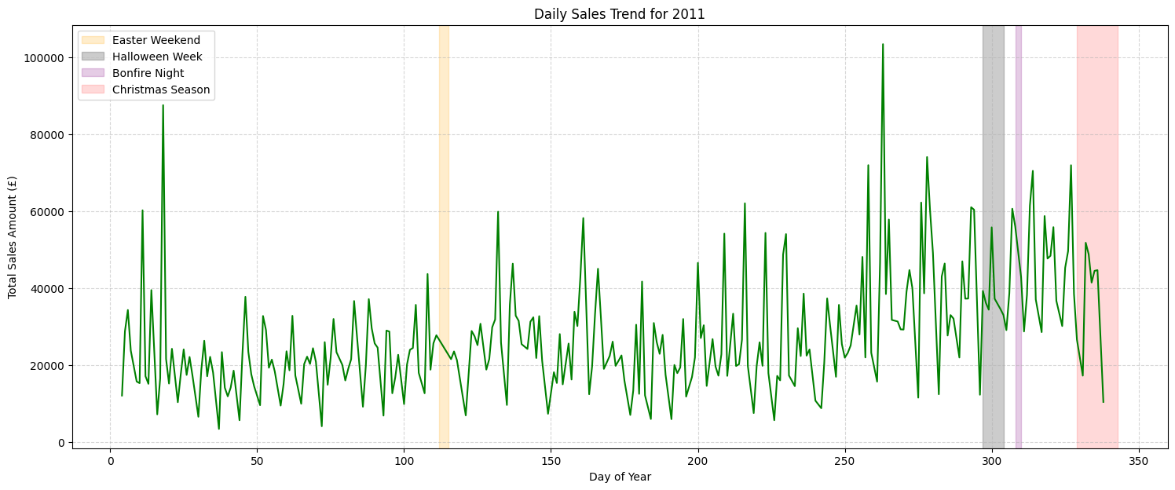
Daily Sales trends For 2011

Slide 6
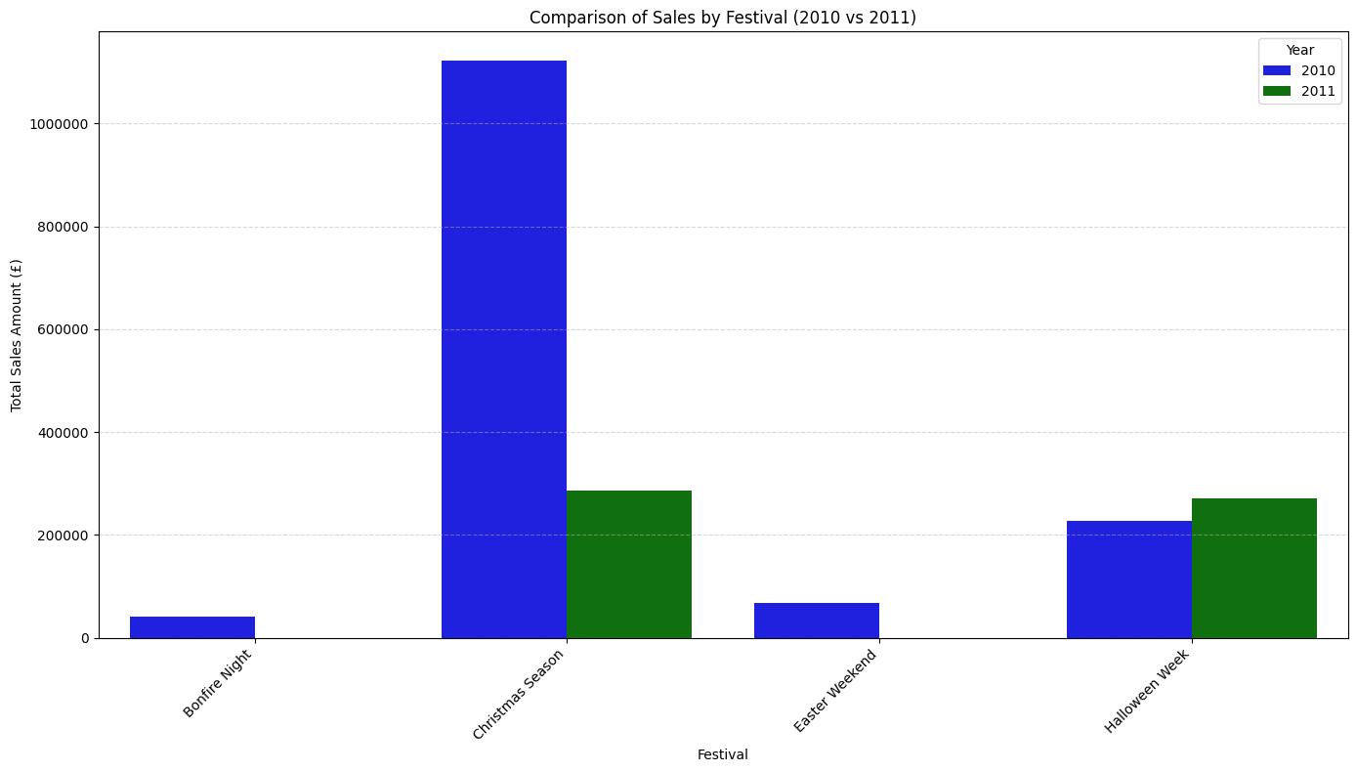
Festival Sales Performance: 2010 vs 2011

Slide 7
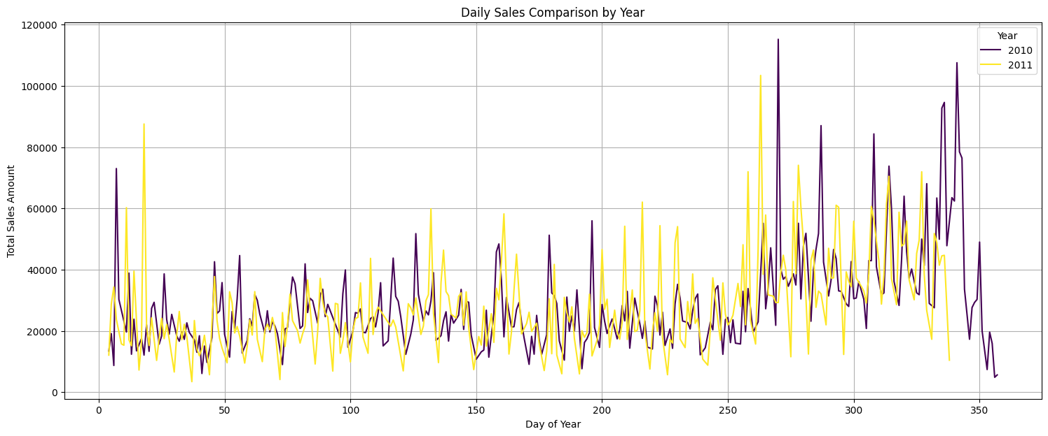
Daily sales trend comparison(2010-11)

Slide 8
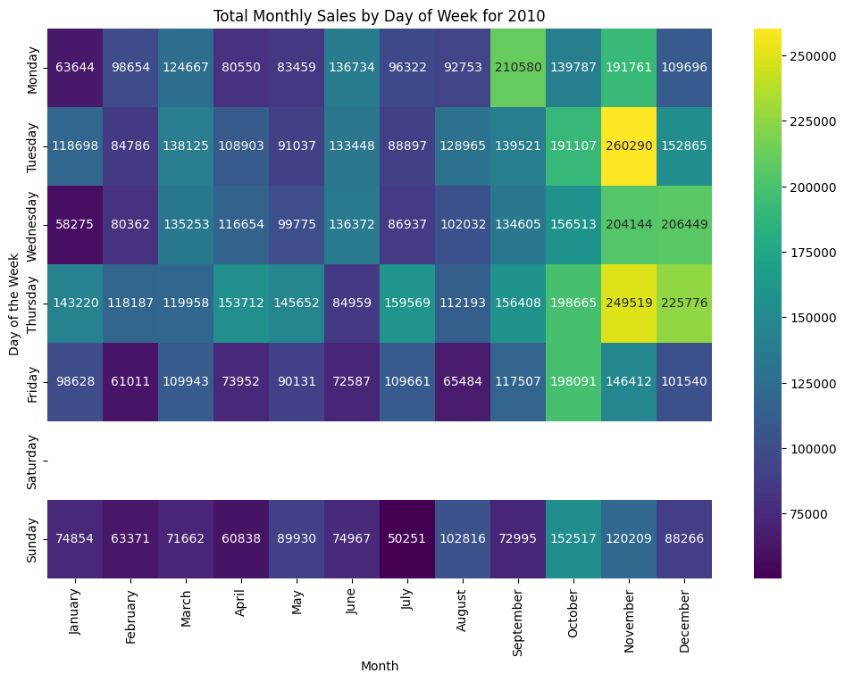
Sales heatmap 2010

Slide 9
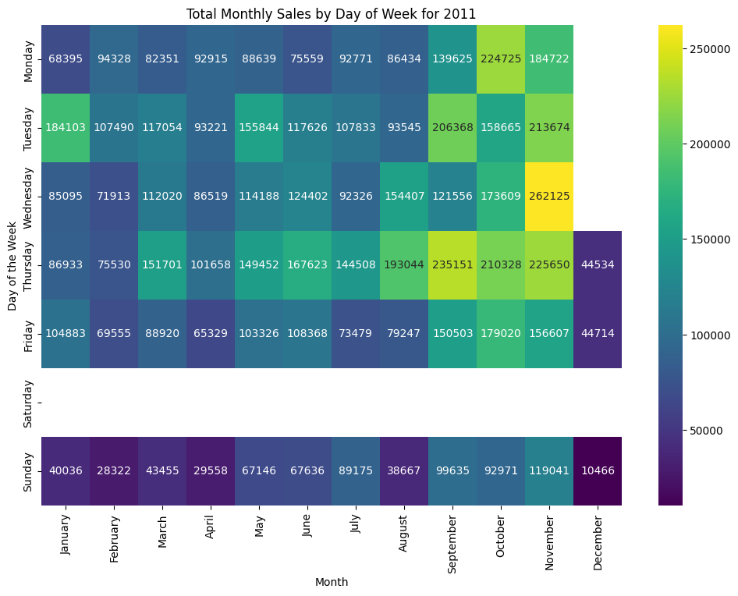
Sales heatmap 2011

Slide 10
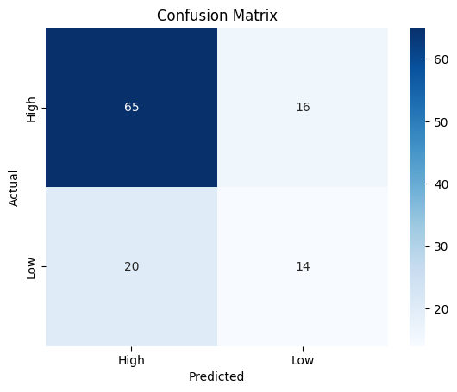
Evaluating the Predictive Model's Performance
A confusion matrix shows you exactly where the model was right and where it was "confused."
Top-Left (True Positives): Correct predictions of "High" sales days. (The model was right) ✅
Bottom-Right (True Negatives): Correct predictions of "Low" sales days. (The model was right) ✅
Top-Right (False Positives): Incorrectly predicted "High" when the day was actually "Low." (The model was wrong) ❌
Bottom-Left (False Negatives): Incorrectly predicted "Low" when the day was actually "High." (The model was wrong) ❌

